Slide 1

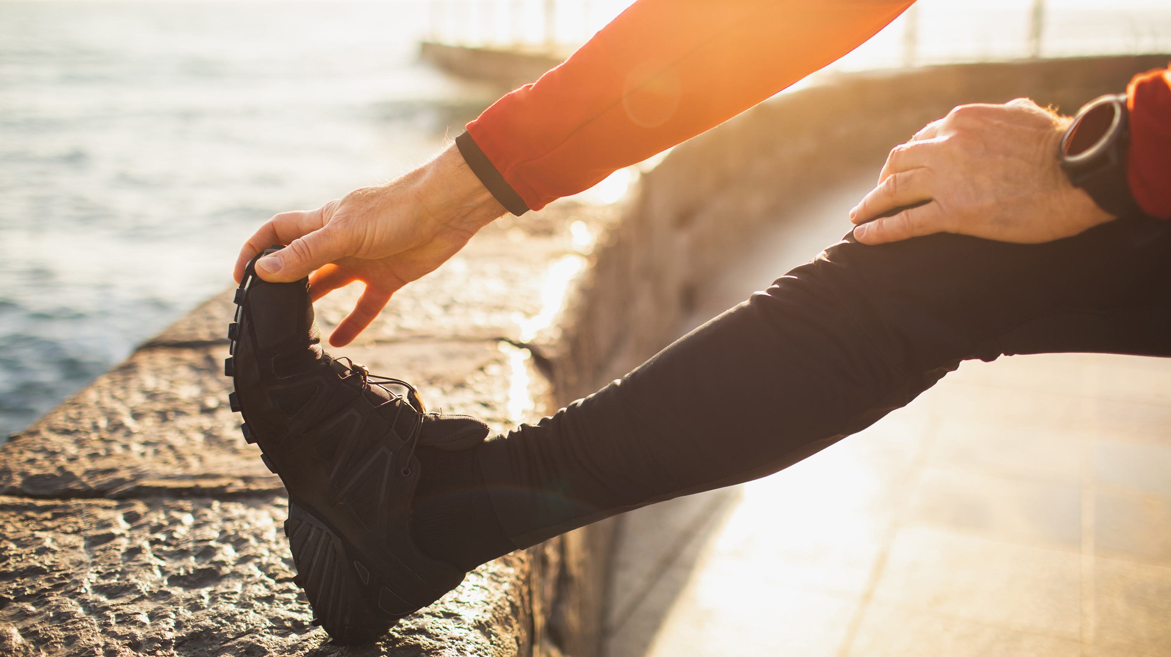
Fueling Your Body for Success
Stephanie Davis, RDN

Slide 2
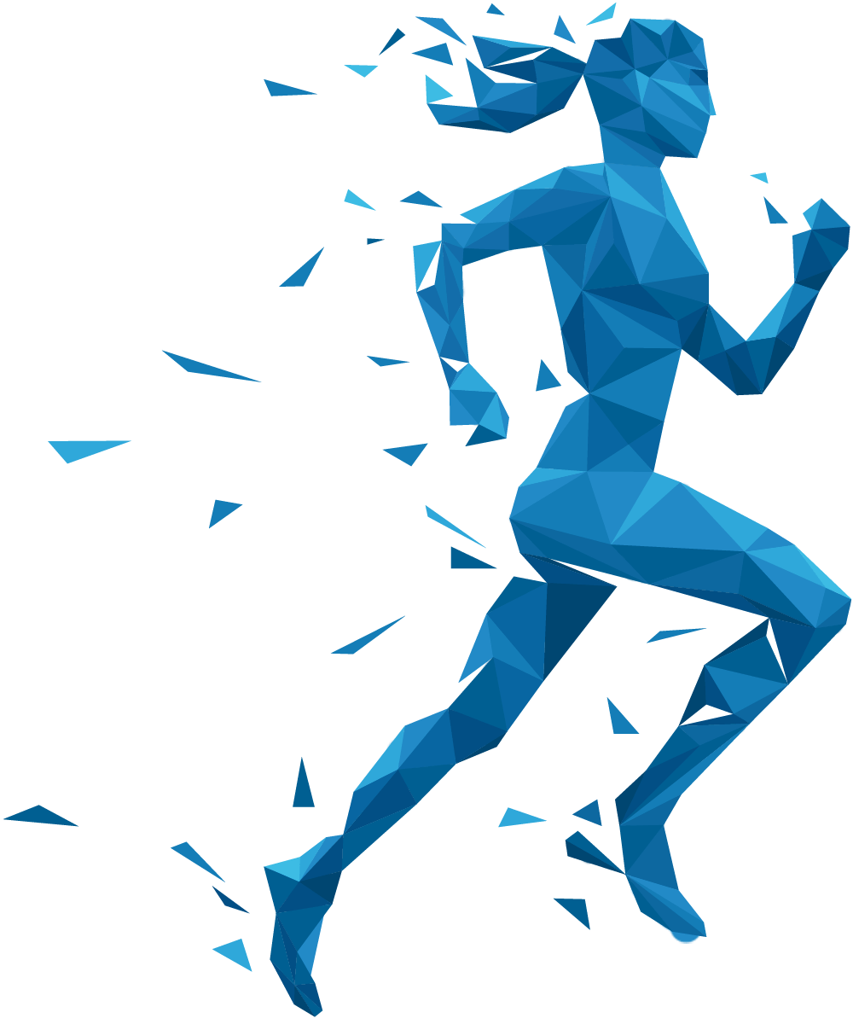
Nutrition and Endurance
Nutrition significantly impacts athletic performance
Serves as the fuel that powers the body
Influences energy levels, recovery, and overall performance

Slide 3
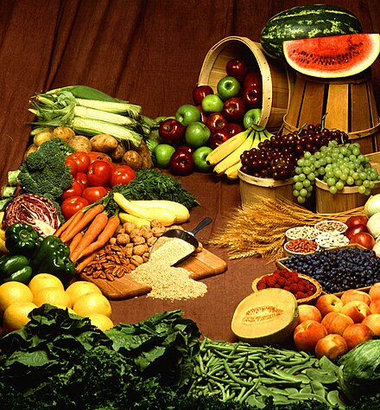
Macronutrients
CARBOHYDRATES
PROTEIN
FAT

Slide 4
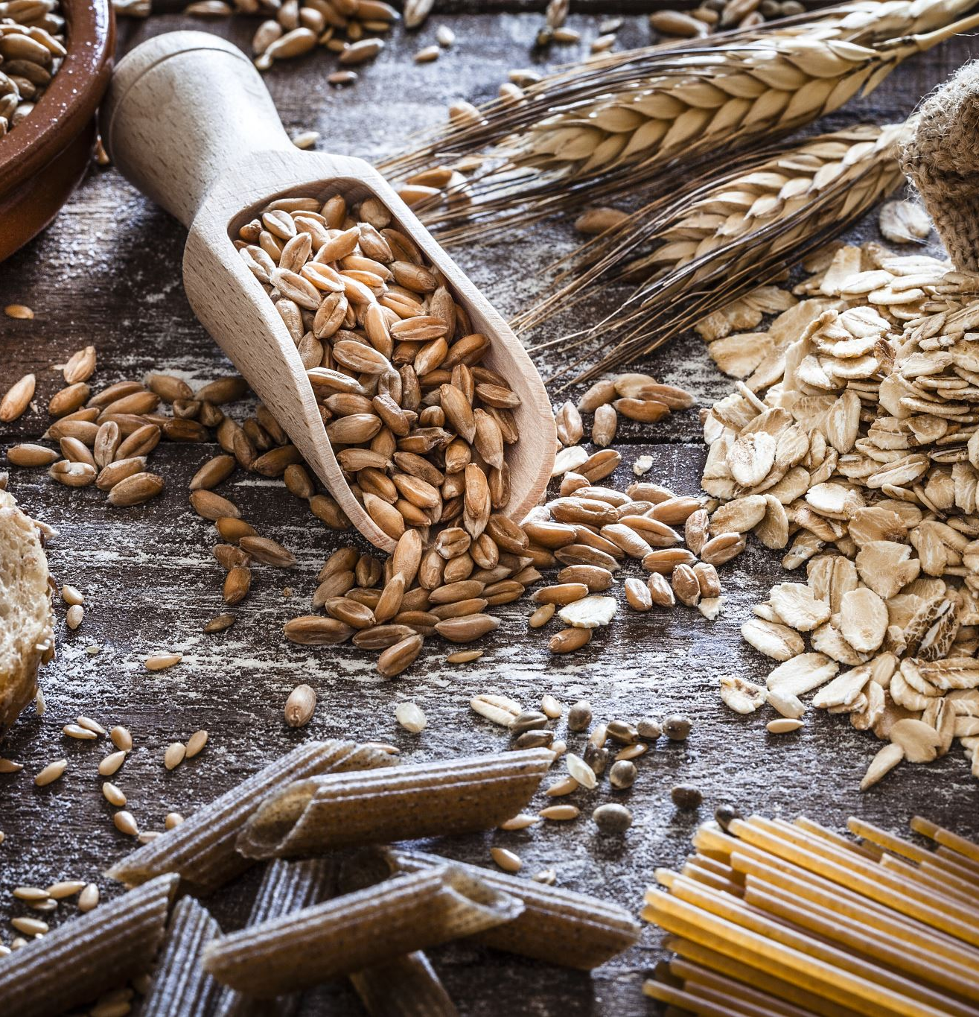
CARBOHYDRATES
Body’s primary source of energy during endurance training
Crucial for sustaining energy levels and optimizing performance
Broken down into glucose
  Fuels muscle contractions during exercise
Glycogen
  Stores glucose in muscles and liver- provides readily available energy for prolonged activity
Recommended intake: ~6-10 grams per kg of body weight

Slide 5
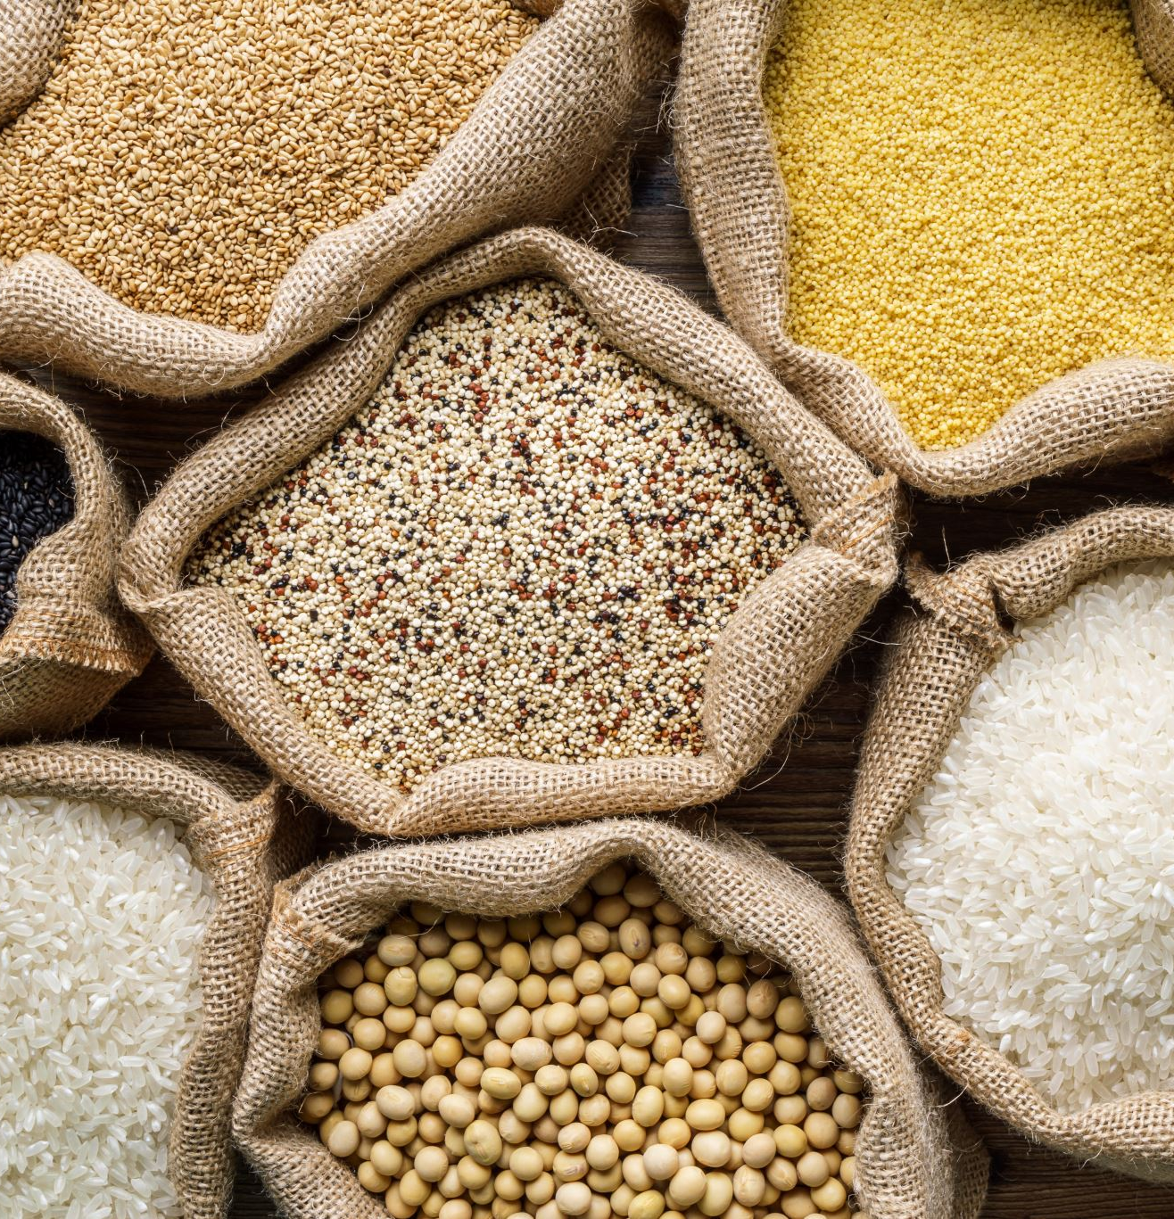
Carbohydrates: Simple Vs Complex
Complex
  Long chain sugar molecules- digested slowly
  Provides sustained energy, satiety, and promotes stable blood sugar levels
  Ideal for endurance training and sustained energy
  Brown rice, quinoa, oats, sweet potatoes, legumes
Simple
  Consists of 1 or 2 sugar molecules- digested and absorbed quickly
  Quick energy release
  Fruits, White bread, candy, soda, fruit juice

Slide 6
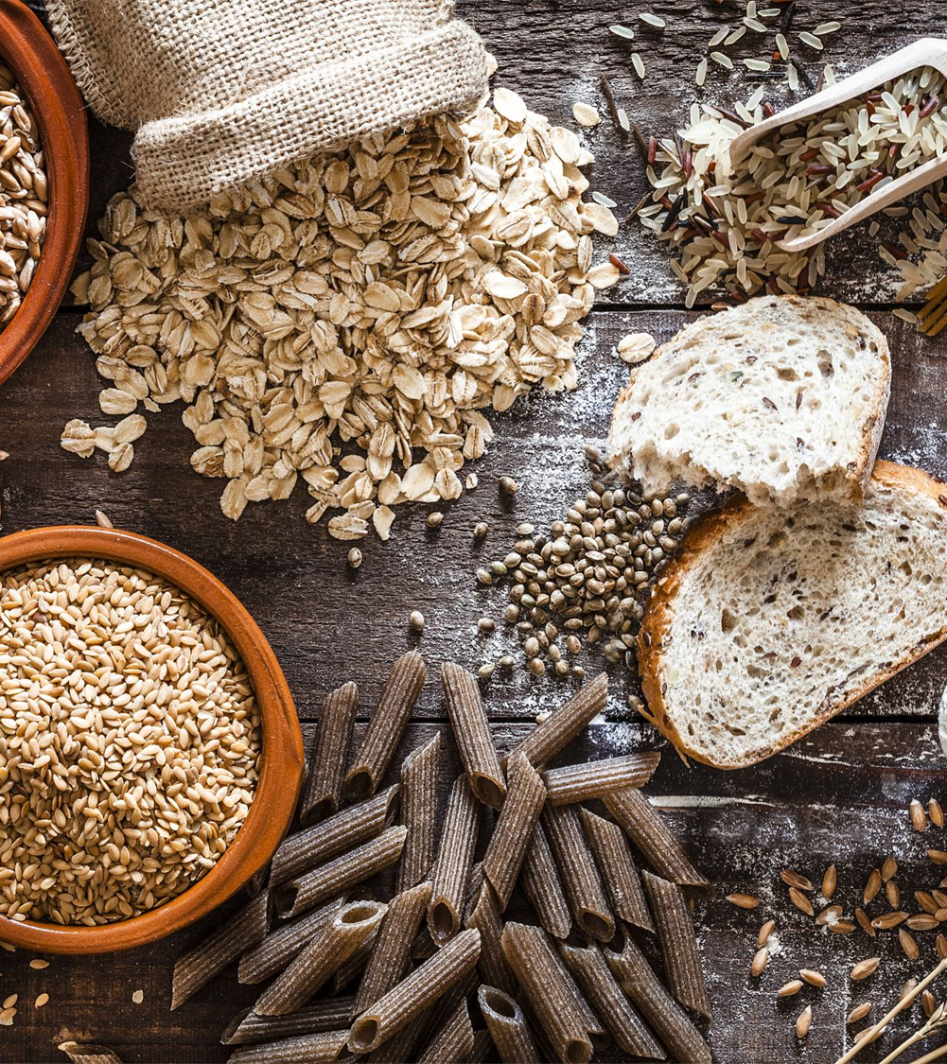
Pre-Race Fuel
Most 10k’s do no require extreme Carb loading
Carb forward foods 1 day before
Focus on complex carbs (whole grains, pasta, rice, sweet potatoes)
Reduce fat and fiber intake to minimize GI discomfort
Hydrate as normal to support carb absorption

Slide 7
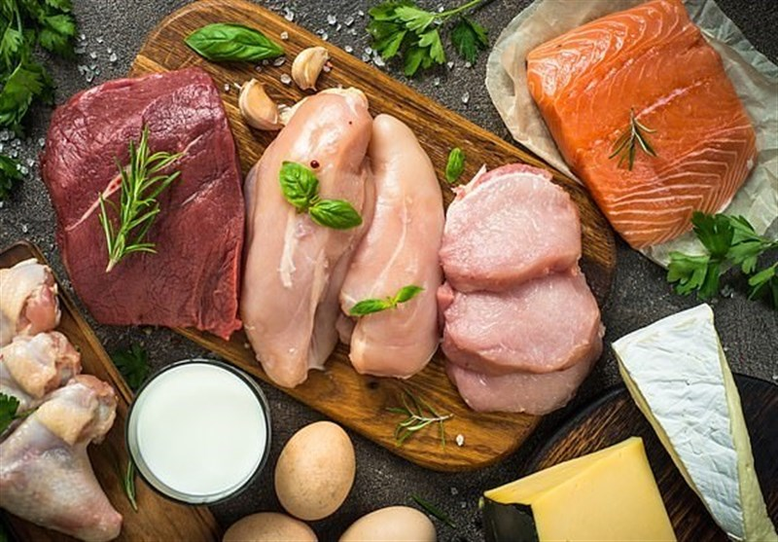
Protein
Essential for muscle repair, recovery, and growth
Plays crucial role in enhancing athletic performance and minimizing muscle damage post- exercise
Recommended Daily Intake: 1.2 - 2.0 grams per Kg body weight
Poultry, eggs, Greek yogurt, tofu, legumes, quinoa, nuts, seeds
This Photo by Unknown Author is licensed under CC BY

Slide 8
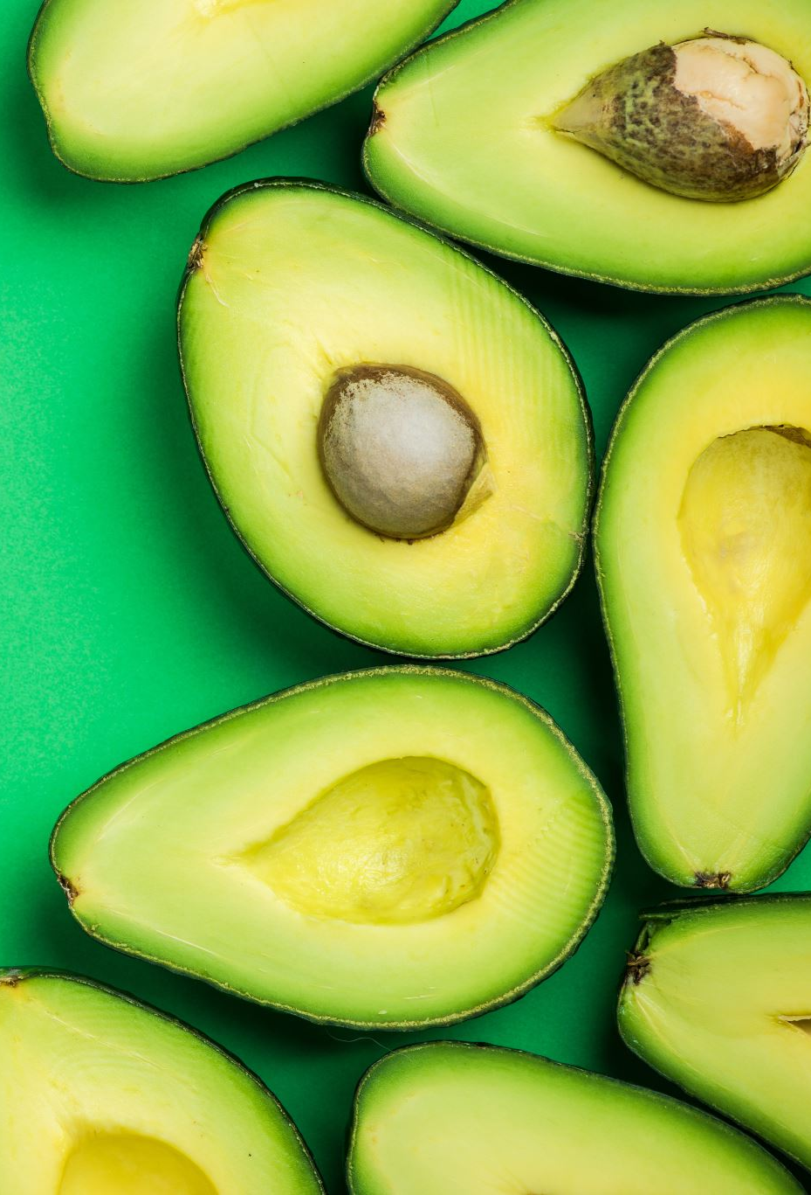
FATS
Provides a slow and steady release of energy
Include healthy fats (monounsaturated and polyunsaturated)
  Nuts, seeds, avocados, fatty fish
Recommended based on individual needs
Avoid very high fat meals before race

Slide 9

Hydration Before
Essential for maintaining optimal performance
  Supports temperature regulation, cardiovascular function, and nutrient delivery
16-20 oz 2-3 hours before
8-10oz 10-20 minutes before

Slide 10
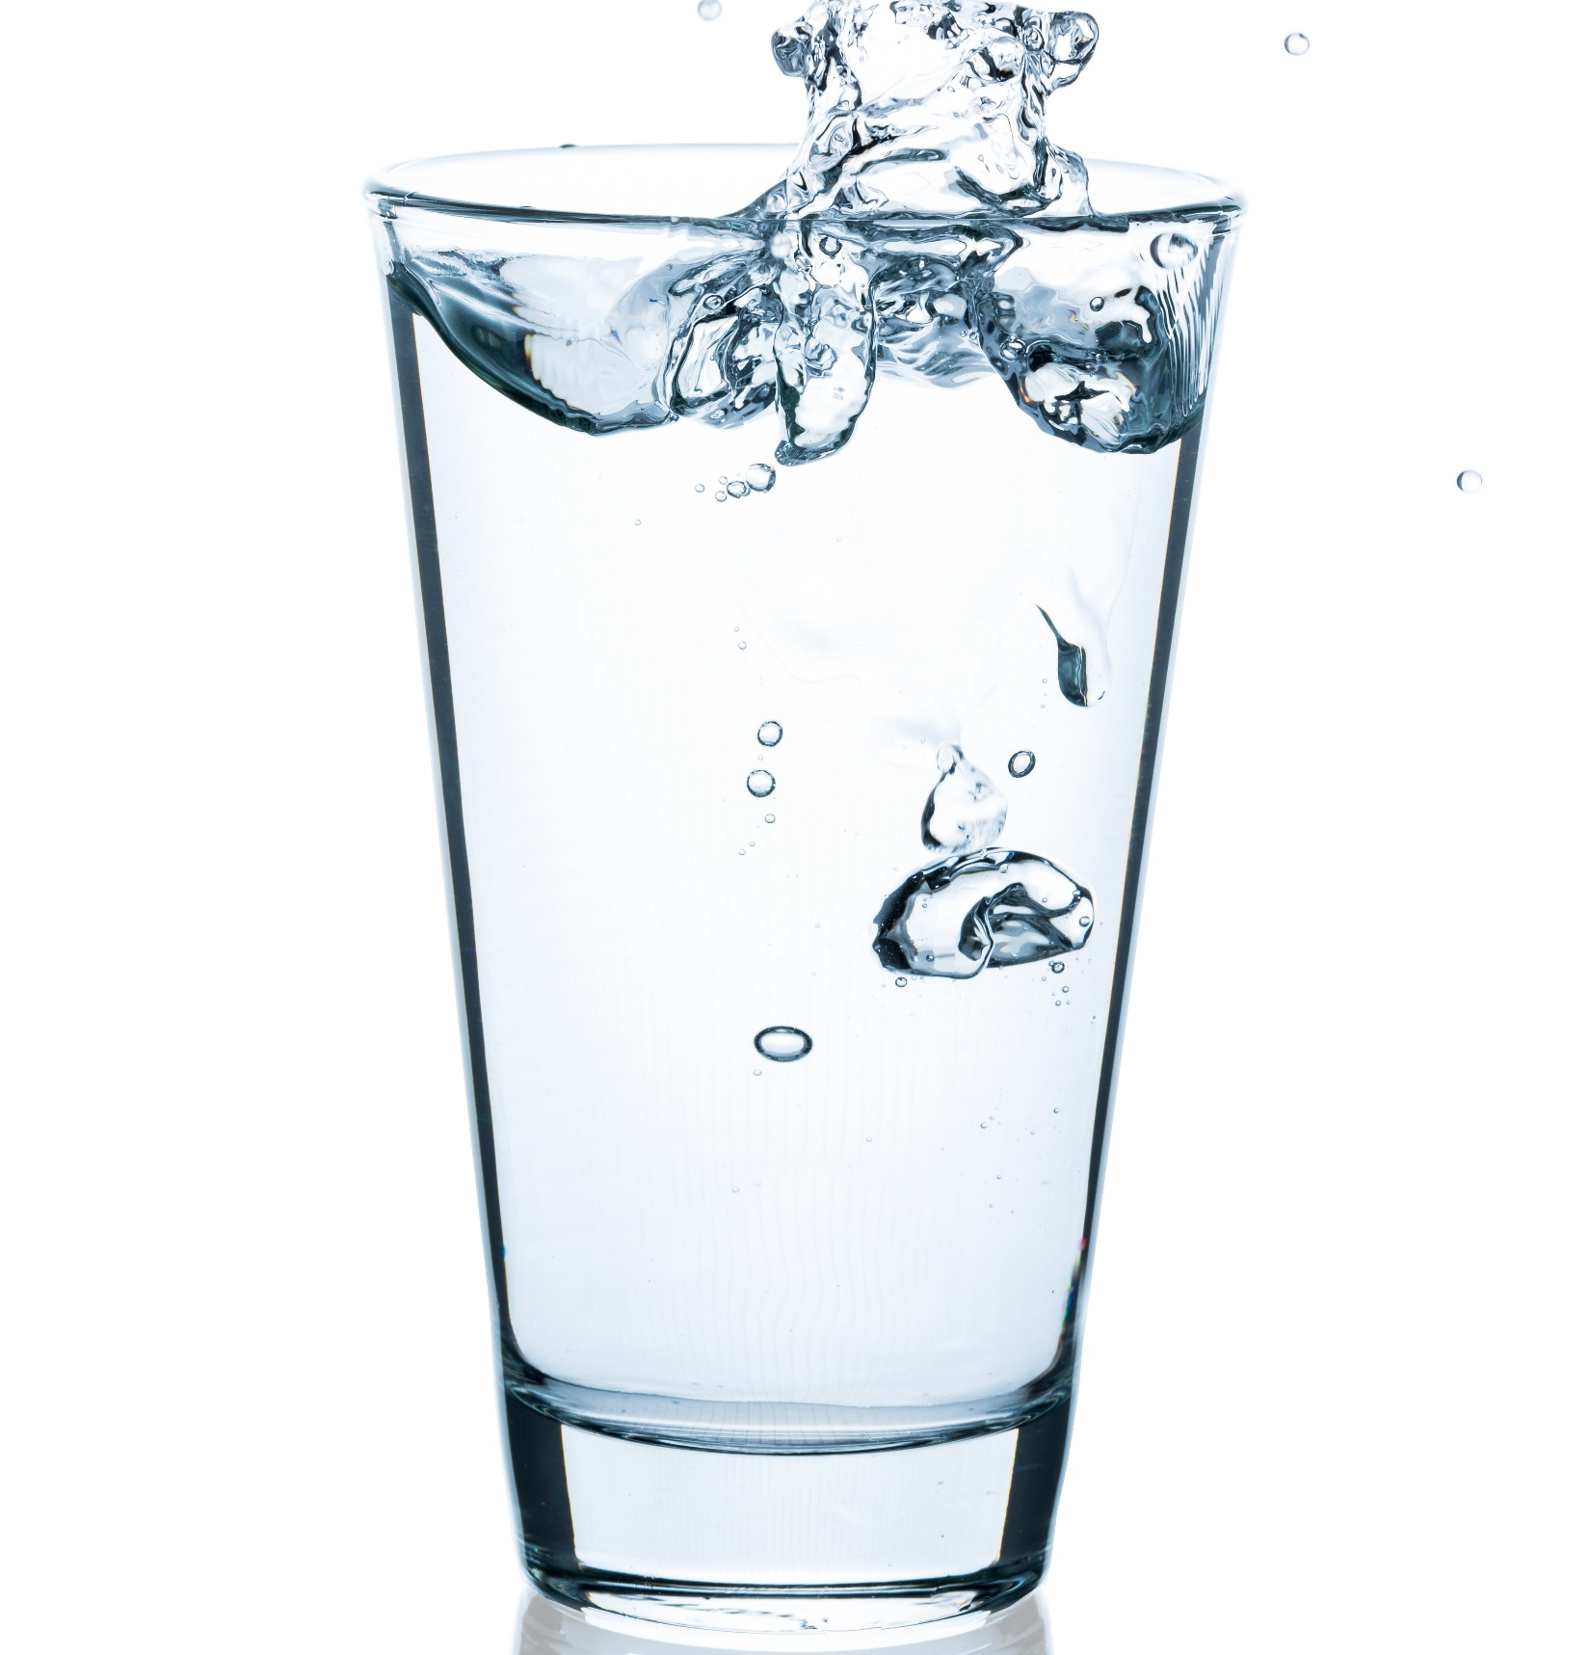
Hydration During and After
During Exercise
  Aim for about ~15-25oz per hour, adjusting based on sweat rate
Post Exercise
  Rehydrate with fluids containing electrolytes
  Aim to drink 16-24 oz for every pound lost

Slide 11

Fueling Before the 10K
Aim for balanced and easily digestible foods
Avoid high-fat and high fiber foods close to race time
1-4 hours before race
  Whole grain toast with almond butter and sliced banana
  1 cup oatmeal with berries and milk
  Greek yogurt with berries and granola
Snack Options:
1-2 hours before race
  Whole grain bagel with low-fat cream cheese or avocado
  Banana with handful of almonds or trail mix
  Rice cakes with almond butter and honey

Slide 12
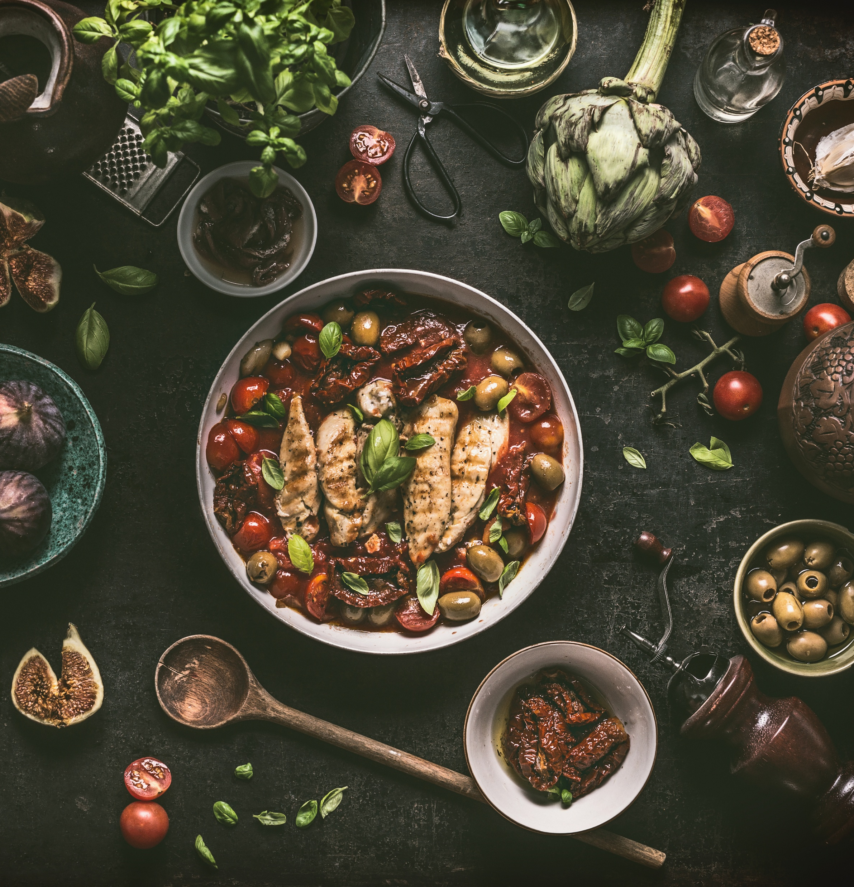
10K Recovery Nutrition
Aim to eat a post meal within 2 hours after finishing race
Include carbohydrates, protein, fats, and fluid
  Grilled chicken stir fry with brown rice and mixed vegetables
    Side salad
    Fresh Fruit (pineapple, berries, and melon)
  Quinoa and black bean bowl with avocado, corn, cherry tomatoes, and cilantro
  Baked salmon with roasted sweet potatoes and brussels sprouts
  Hydrate and replace electrolytes lost

Slide 13
Keep it Simple
Carbohydrates will support your performance
Extreme Carb Loading is not necessary
Protein will help with muscle recovery
Hydration should match sweat lost
Recover with carbs and protein
Avoid new foods on Race day

Slide 14

Stephanie Davis
Daviss@ymcarichmond.org

Slide 15
References
Thomas DT, Erdman KA, Burke LM.Nutrition and Athletic Performance.Medicine & Science in Sports & Exercise. 2016;48(3):543-568.(Joint Position Statement: American College of Sports Medicine, Academy of Nutrition and Dietetics, Dietitians of Canada)
Sawka MN, et al.Exercise and Fluid Replacement.Medicine & Science in Sports & Exercise. 2007;39(2):377-390.(American College of Sports Medicine Position Stand)
Jäger R, et al.International Society of Sports Nutrition Position Stand: Protein and Exercise.Journal of the International Society of Sports Nutrition. 2017;14:20.

