Slide 1
FITNESS TRIVIA
5/27/20
Right Answer = we only do 10 of the exercise!
Wrong Answer = we all do 15 of the exercise!

Slide 2
What is the name of this muscle?
Tricep
Bicep
Quadricep
Deltoid

Slide 3
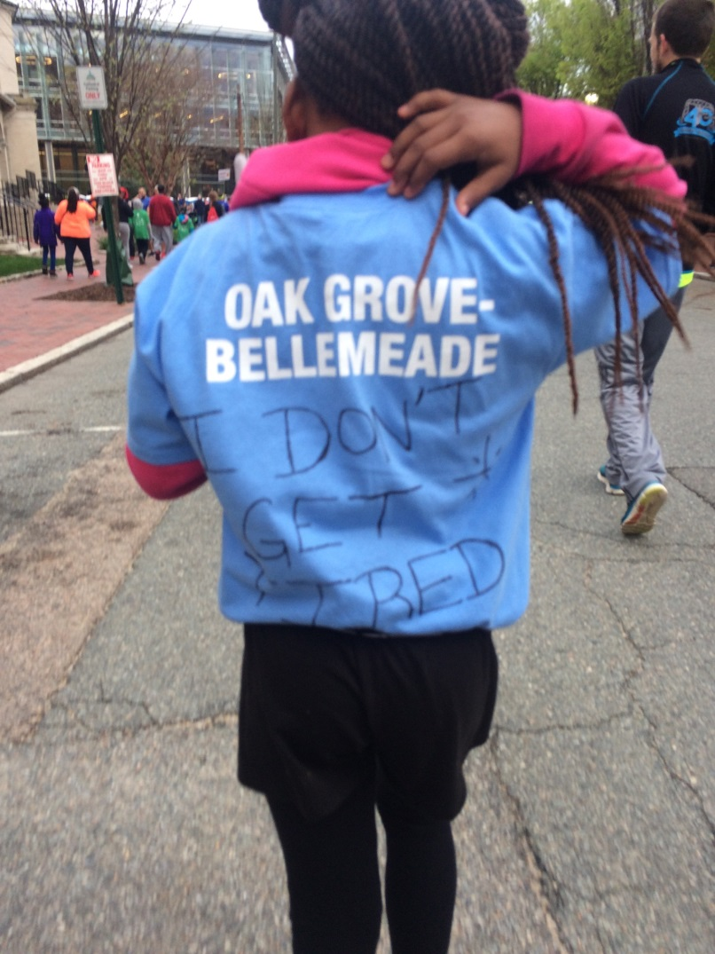
Which of the following is Not a benefit of regular exercise?
Decreased chance of heart disease
Decreased chance of type 2 diabetes
Improved eye sight
Improved brain health

Slide 4
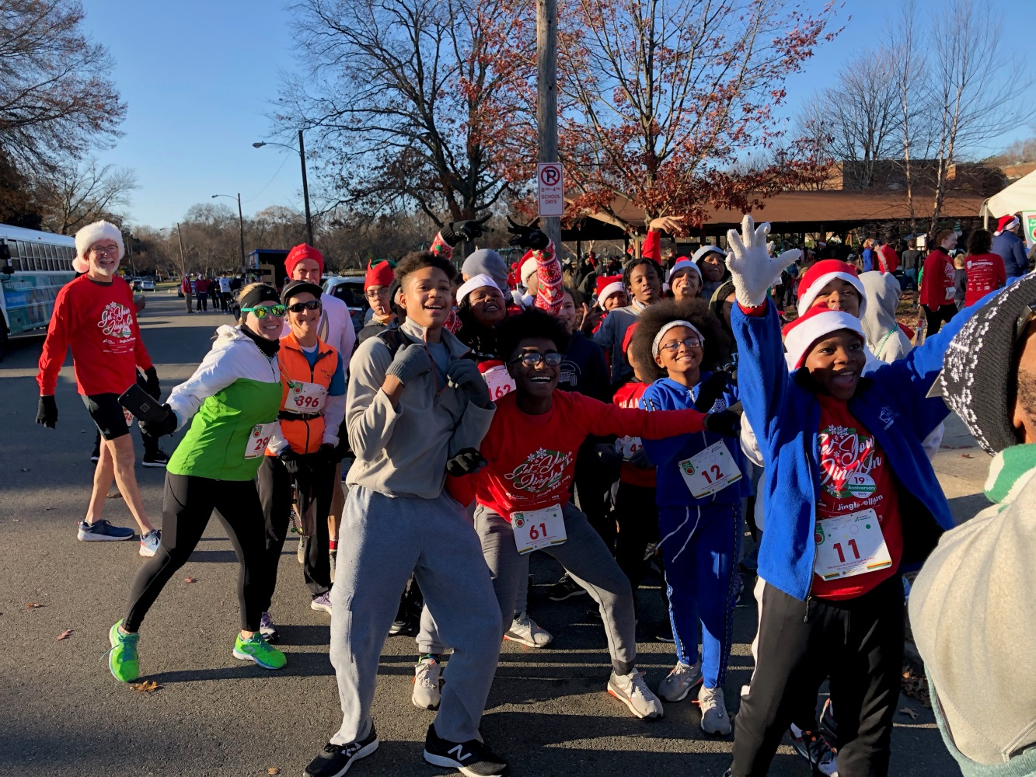
What is the distance, in miles, of a 5k?
5 miles
3.1 miles
6.2 miles
15 miles

Slide 5
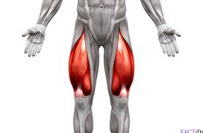
What is the name of this muscle?
Calf
Trapezius
Bicep
Quadricep

Slide 6
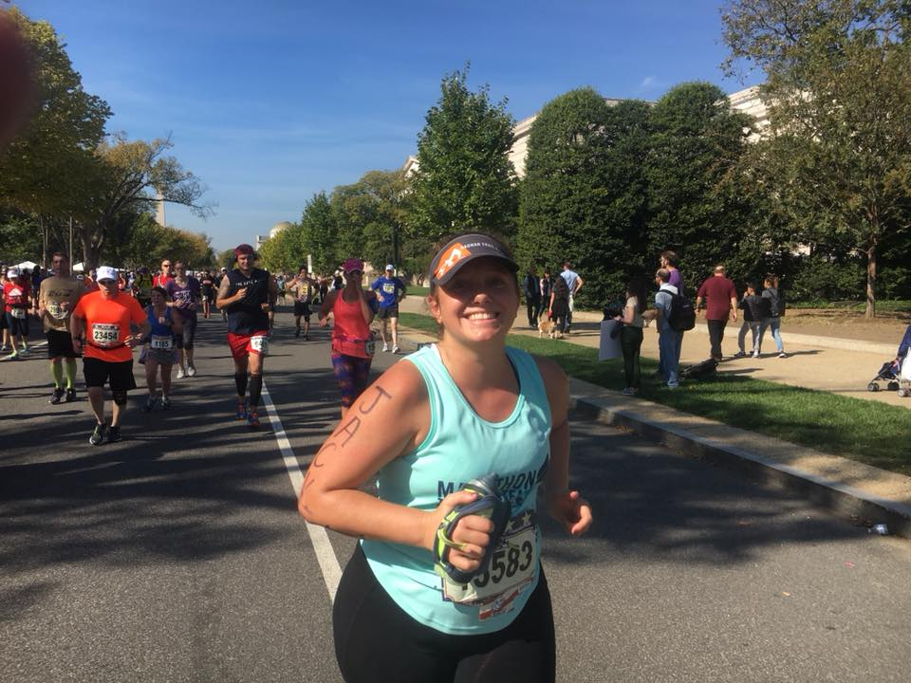
What is the distance, in miles, of a full marathon?
26.2 miles
10 miles
13.1 miles
15 miles

Slide 7
What is the best exercise, out of the ones listed below, to develop your abdominal muscles?
Squats
Running
Plank
Washing Machines

Slide 8
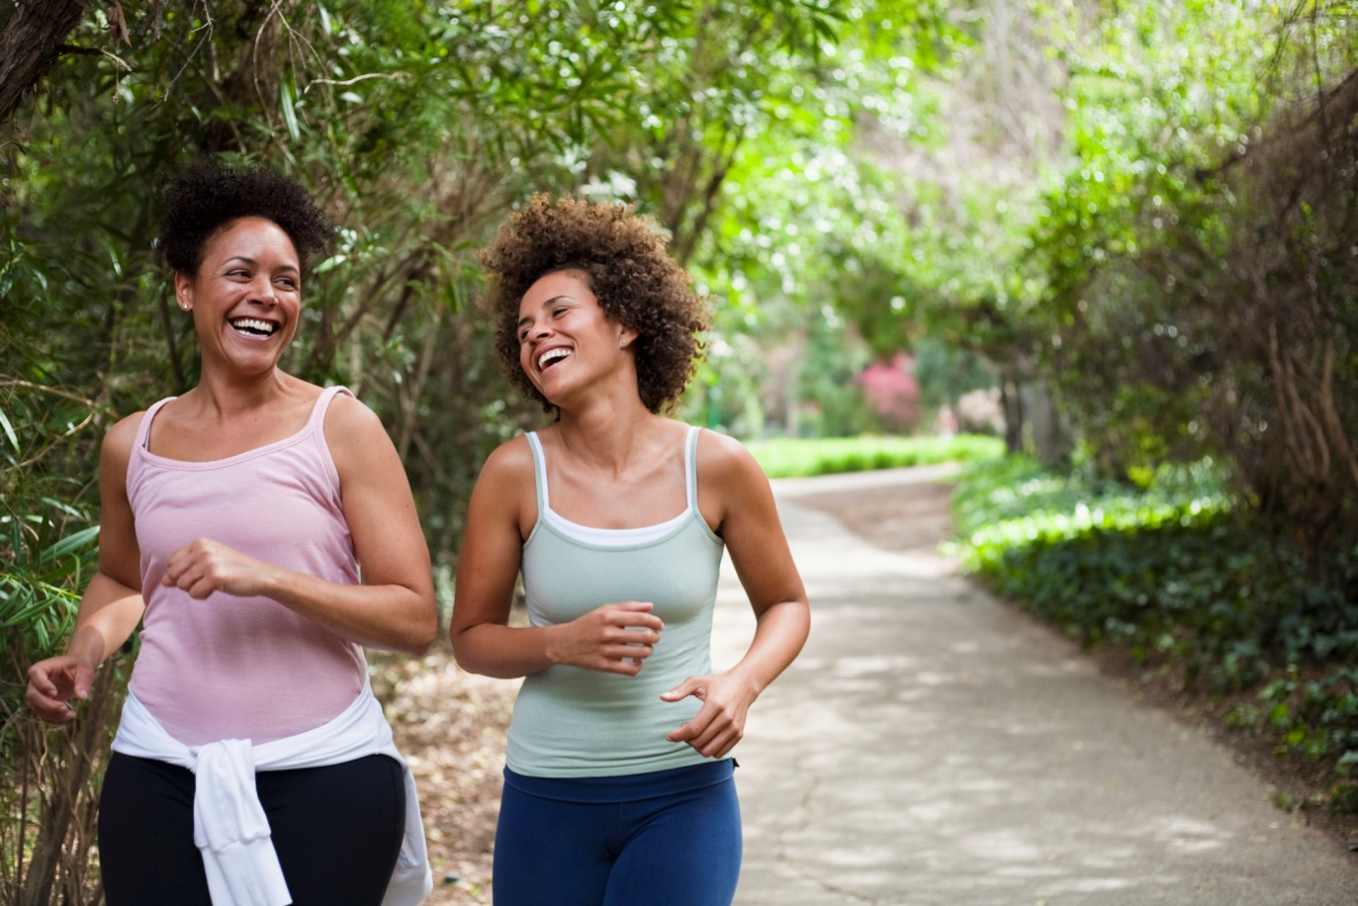
Kids are supposed to get 60 minutes of physical activity per day? What is the recommended minimum amount of physical activity for adults?
90 minutes per day
150 minutes per week
30 minutes per day
240 minutes per week

Slide 9
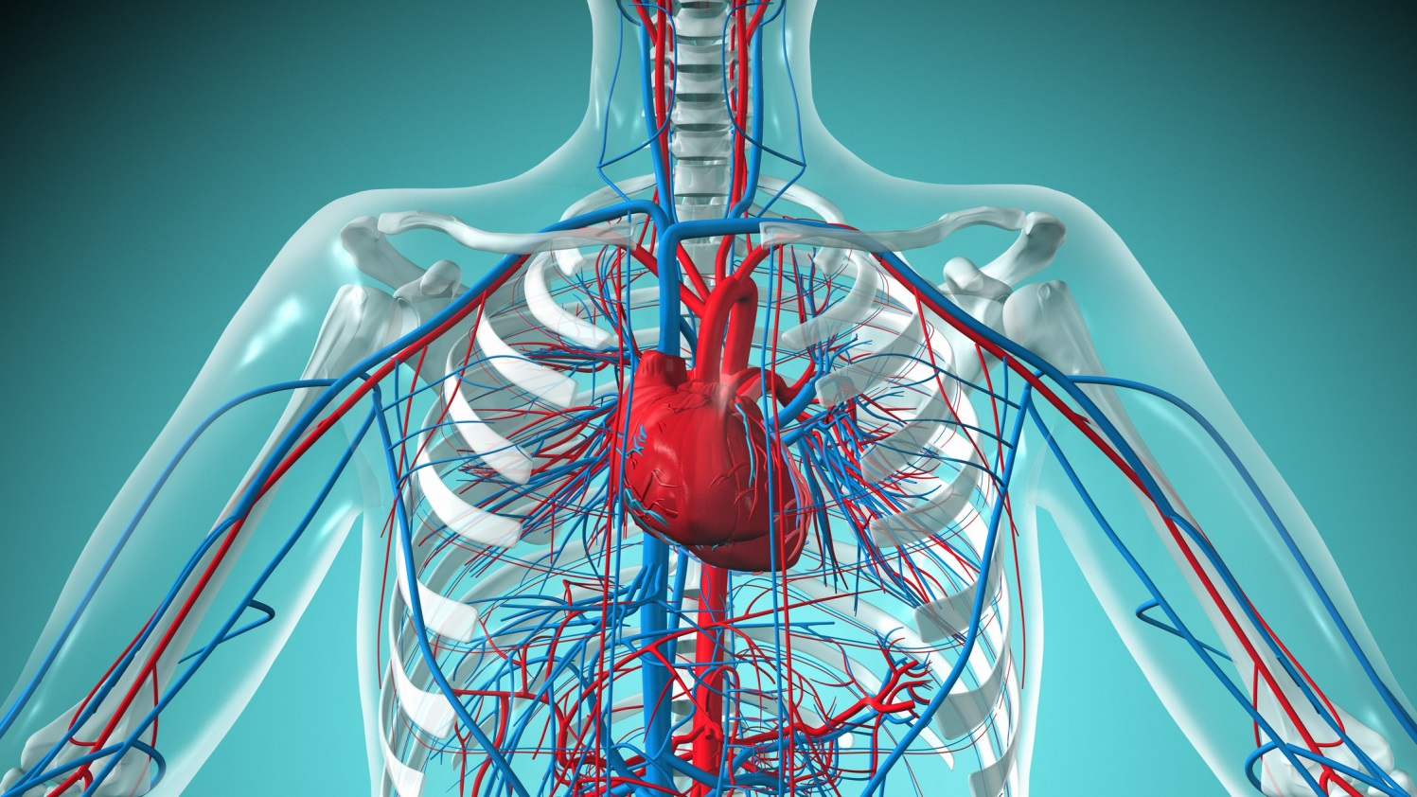
Which exercise, of those listed below, is the best to improve your cardiovascular health?
Push Ups
Walking
Crunches
Planks

Slide 10
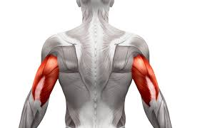
What is the name of these muscles?
A. Biceps
B. Triceps
C. Hamstrings
D. Obliques

Slide 11
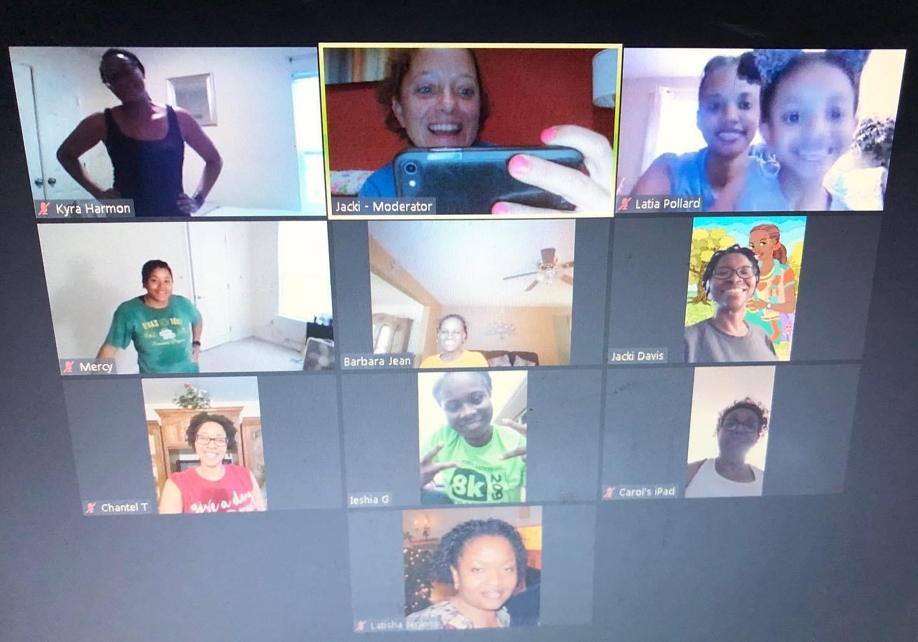
What is the best workout out of those listed below?
30 minute walk
45 min. class with Coach Jacki & Chaz
3 minute plank
15 minute jog

