Slide 1
WELCOME TO BOOT CAMP
THESE SLIDES WILL SERVE AS YOUR DRILL INSTRUCTOR.
RUN WHEN IT SAYS TO RUN.
EXERCISE WHEN IT SAYS TO EXERCISE.
THEN RUN AGAIN.
THEN EXERCISE AGAIN.
YOU GET THE POINT.
NO EXCUSES.
GO HARD OR GO HOME!

Slide 2
RUN!

Slide 3
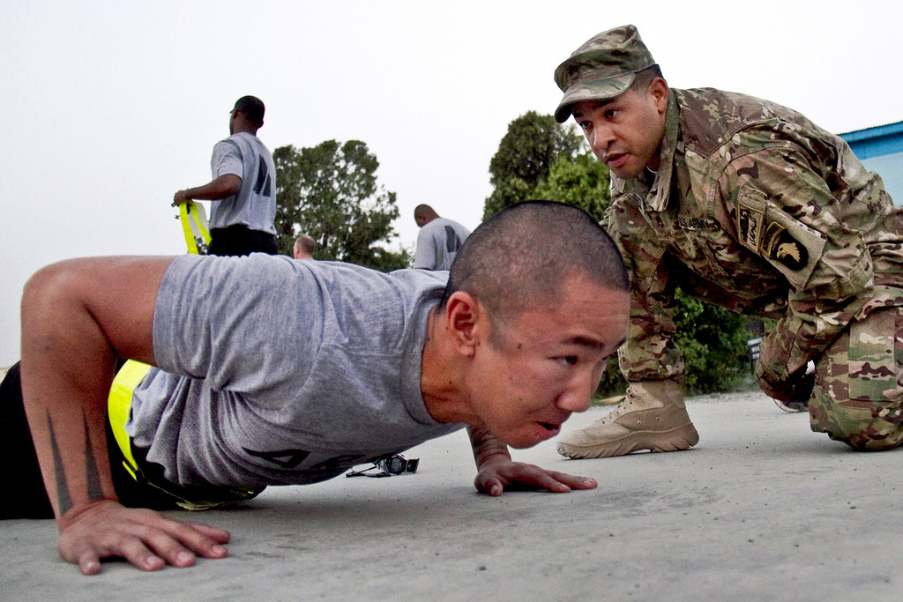
10 PUSH UPS

Slide 4
RUN!

Slide 5
15 SIT UPS

Slide 6
RUN!

Slide 7
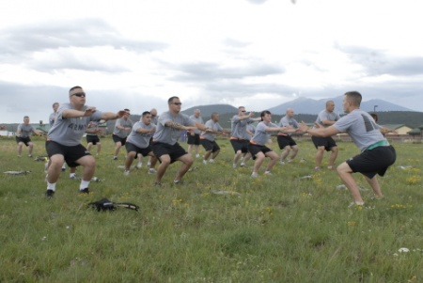
25 SQUATS

Slide 8
RUN!

Slide 9
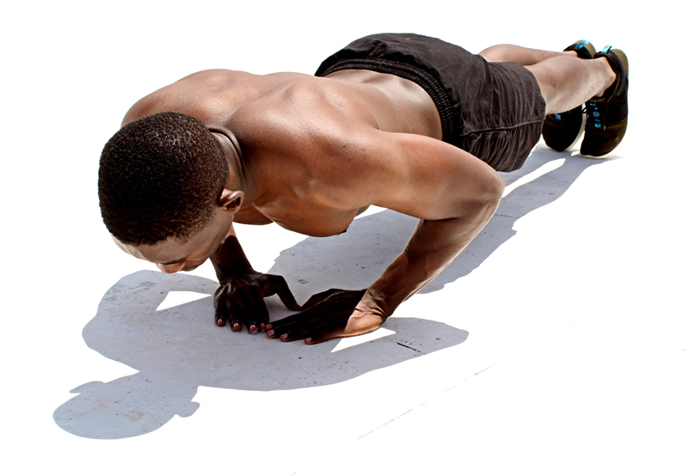
10 DIAMOND PUSH UPS

Slide 10
RUN!

Slide 11
20 LUNGES

Slide 12
RUN!

Slide 13
1 MINUTE PLANK

Slide 14
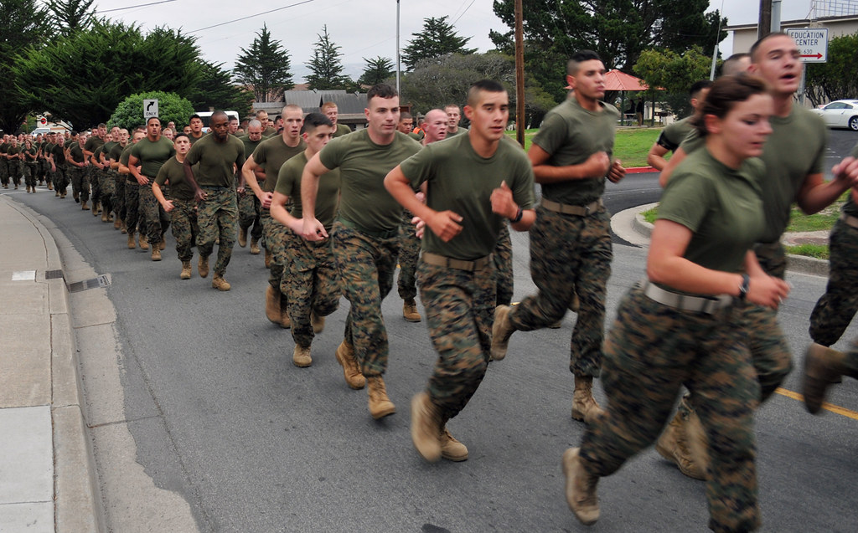
RUN!

Slide 15
20 BICEP CURLS

Slide 16
RUN!

Slide 17
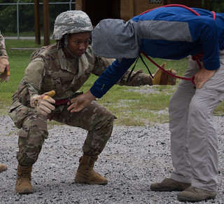
30 SECOND WALL SIT

Slide 18
BOOT CAMP COMPLETE

