Slide 1
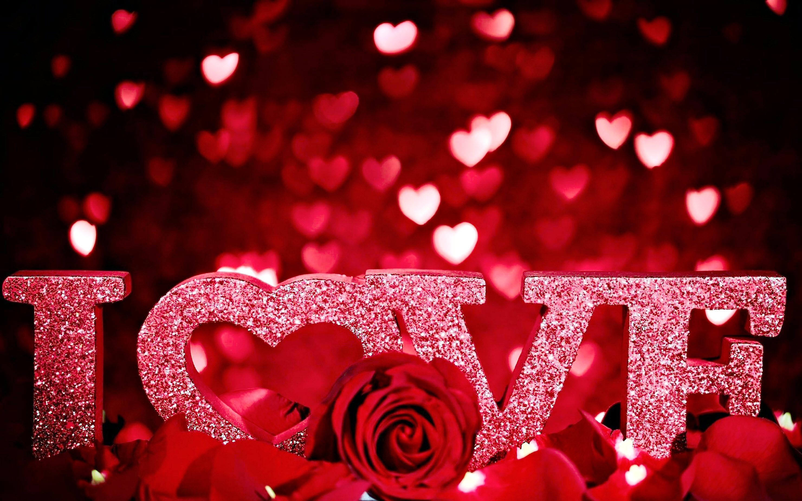
Valentines Workout Riddles

Slide 2
Roses are red, Violets are blue.
This exercise is my least favorite, but I will do them for you.

Slide 3
You are my favorite person. Of that, I have no doubt. I never want to leave you, never want to say goodbye. When we are together, I believe we can fly.

Slide 4
You are my super hero, the one I’ll always love. I wish we could be together, flying high above.

Slide 5
If you were at the top of a mountain, I would find a way to climb. And once I made it to the top, you’d be mine til the end of time.

Slide 6
In my lifetime, I know there will only be a few. You are the one I love, I’d run to the end of the earth for you!

Slide 7
My heart skips a beat whenever I’m with you. What I love the most is when it’s just us two.

Slide 8
They say to shoot for the moon and you’ll land among the stars. I feel like we get both with a love as strong as ours.

Slide 9
For you, I would do anything, just name what you want me to do. There is no limit to my love, nothing I would not do.

Slide 10
Your love lifts me higher, higher than I’ve ever been lifted before. I love our time together, I only wish we had more.

Slide 11
When you’re by my side, I want to jump for joy. When I’m without you, I want to eat Chips Ahoy!

