Slide 1
Using the Digital Headcount

Slide 2
Why Care?
To measure the amazing work you are doing and the work of the program
To maintain liability coverage in case an incident occurs in your class
One of many ways to keep Command in the loop about how your class is going

Slide 3
When is it due?
Digital Headcount: due on a weekly basis
If there is missing paperwork, Command will contact you with a comment reminder in the sheet that will also send to an email notification
Make sure to keep your documents in a safe place until it needs to be submitted since participant’s personal information is on there
Notes:
If there is missing paperwork or attendance, we will leave a comment in your sheet and send an email notification. When collecting your paperwork, keep documents in a safe place where only you have access to protect participants’ personal information, until it is required for you to submit them

Slide 4
Where Can I find it?
All up to date forms can be found online at the following link:
https://www.sportsbackers.org/warriors-materials/

Slide 5
Step by Step How to Use the Digital Headcount

Slide 6
Before you start...
Make sure you have a strong internet connection
You can access the Digital Headcount Sheet from a computer or mobile device. If you are using a mobile device (phone, tablet), you must download the Google Sheets App in order to edit the sheet. You also will need a Google account. We will discuss what that means in the next slide.
Go to the Warriors Materials page and click on the link to the Digital Headcount Sheet for your class

Slide 7
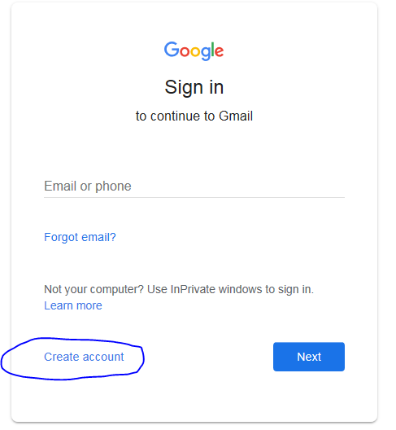
Step 1
Make sure you have a google account.
If you have a gmail email address, you already have one. Go to Step 2.
If you have another email address, Go to Gmail.com and click create account
You can also download the Google sheets app on your phone to log in.

Slide 8
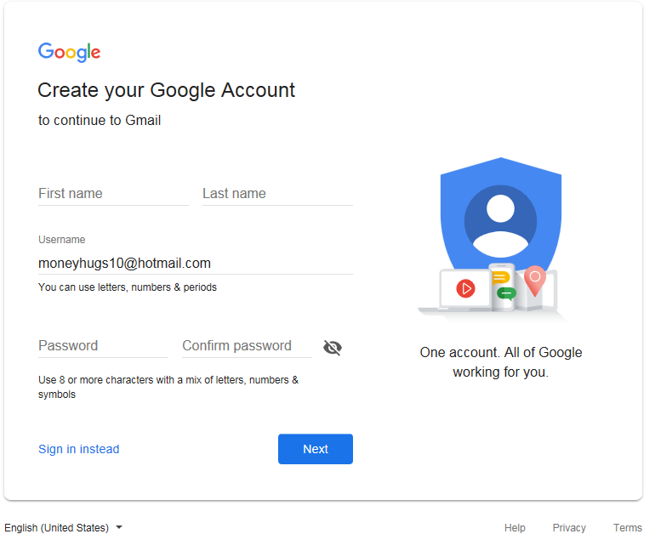
Step 1
It will send you to this page where you have to fill in your information. Notice that you don’t need a Gmail.

Slide 9
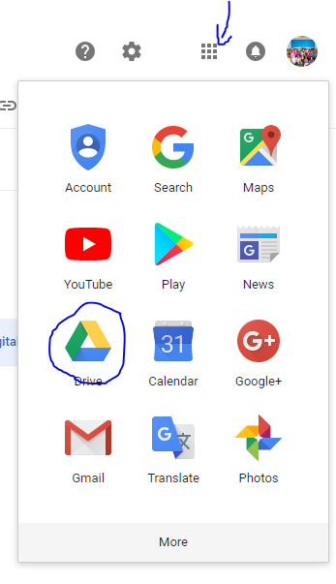
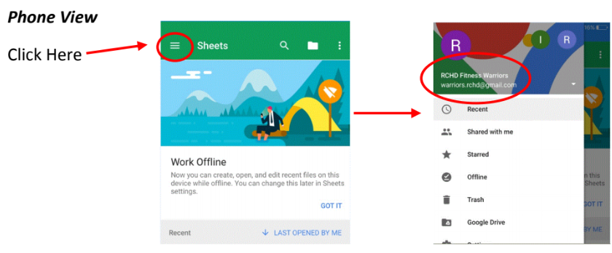
Step 2
Computer View
Once you log in, click the box in the upper right hand corner and select the drive icon.
All the documents you have access to will be in the drive.

Slide 10
Step 3
To access your sheet, scroll through the names at the bottom and click on the one that’s yours. Each sheet is protected, which is why it’s important to make sure you are logged into the right email in order to access your sheet.

Slide 11
Step 4
Enter your headcount numbers for each class as soon as possible. A summary for each month will be automatically calculated to the right. The Digital Headcount Sheet saves automatically as you enter in your attendance.

Slide 12
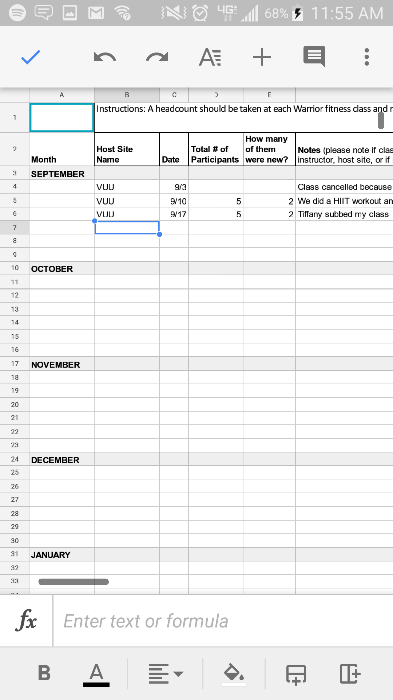
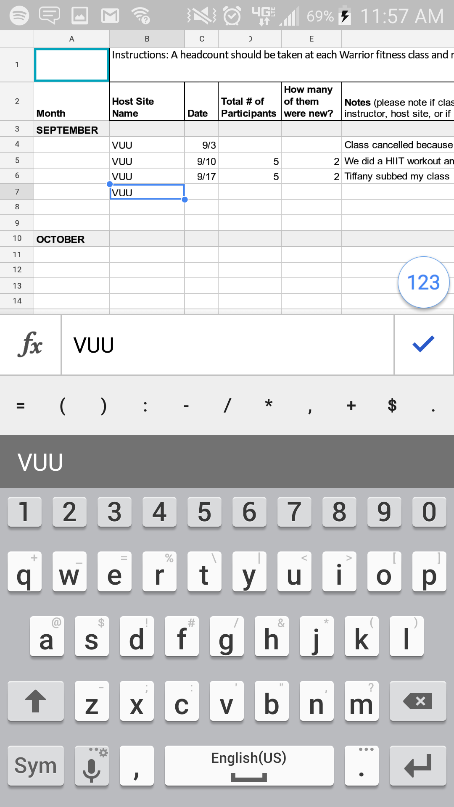
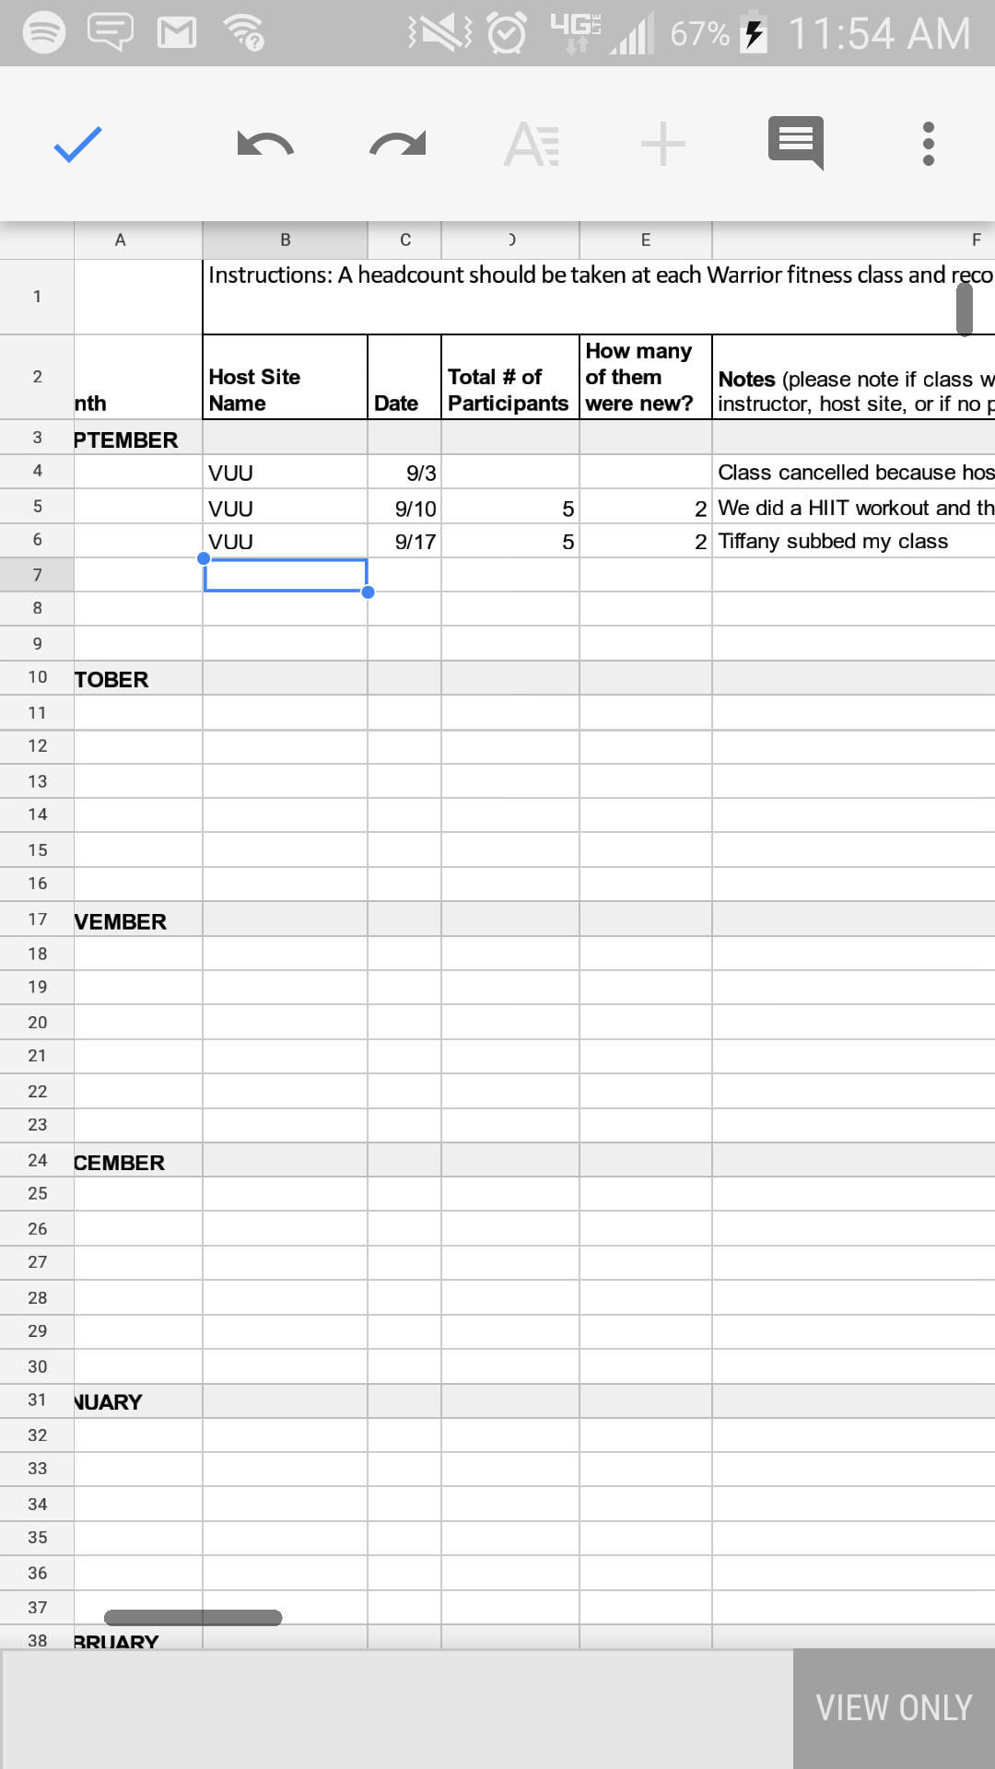
Step 4
Phone View

Slide 13
NOTE
There IS a difference between a canceled class and no one showing up. This changes your averages and the calculated averages as a whole.
If no one shows up, type in a zero.
If you cancel class, leave the space blank or type in a dash sign (-)

Slide 14
Common Problems and Solutions
I’ve clicked on the link but it shows as VIEW ONLY or PROTECTED
Make sure that the email you are logged into is registered under a Google account. You should be able to gain access once it’s registered. You don’t need to have Gmail to gain access, just register with the email you provided (review step 1.).
If you download the app on your computer or smartphone, check which email it’s logged into since the app registers to the last Gmail account used (review Step 1.).

Slide 15
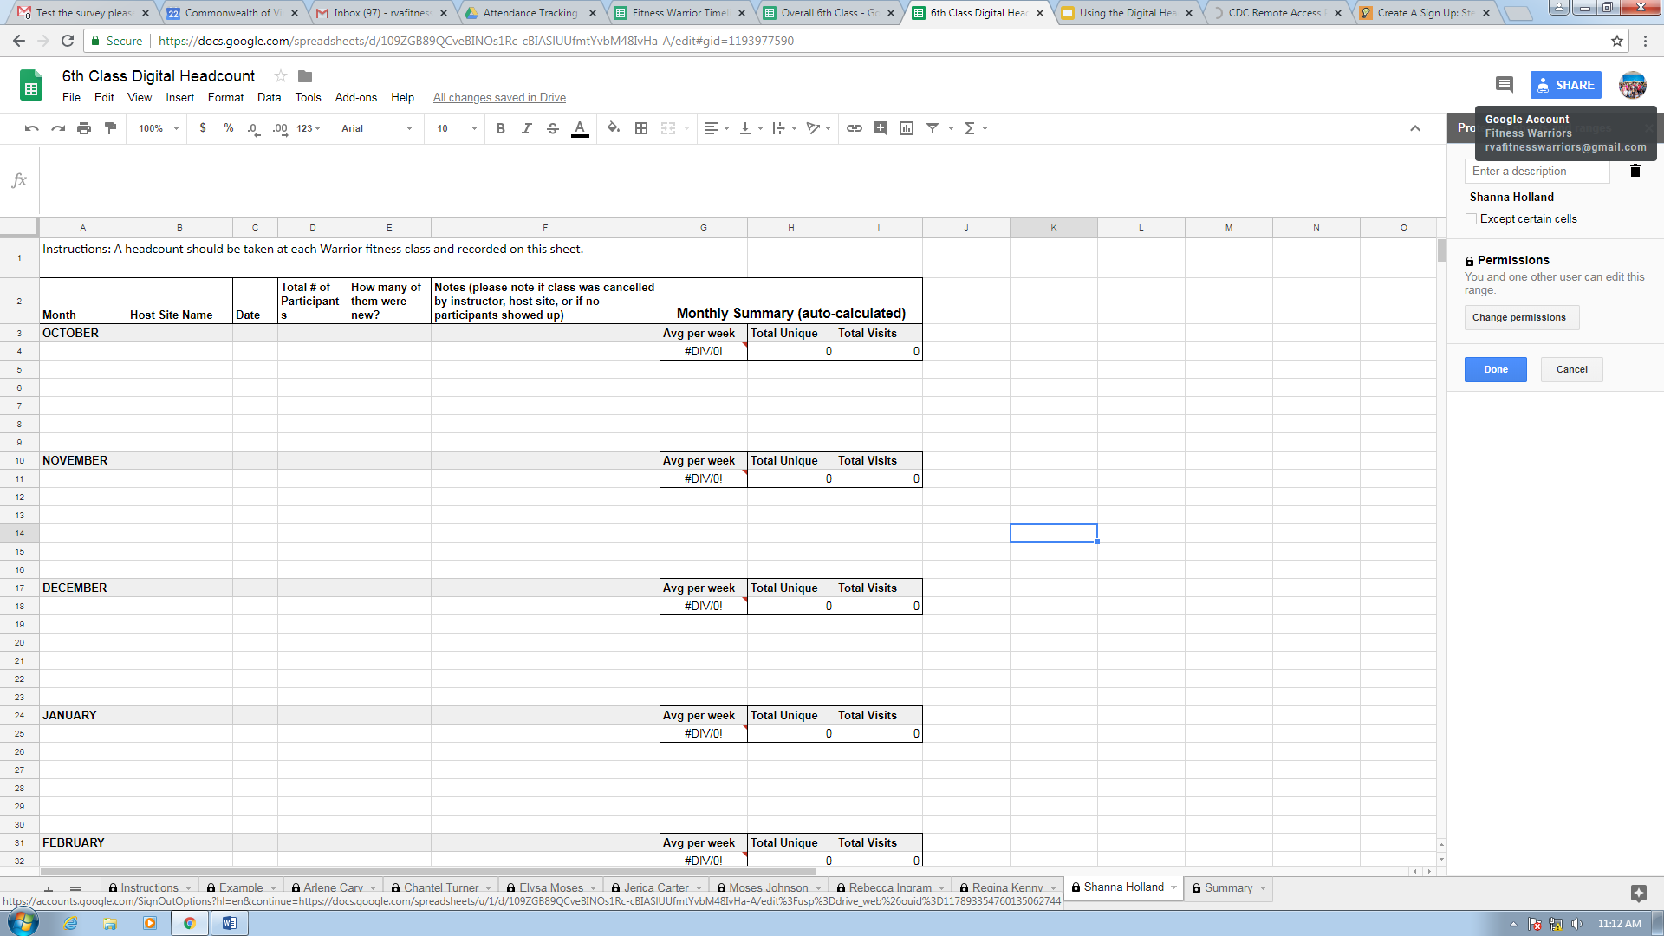

Slide 16
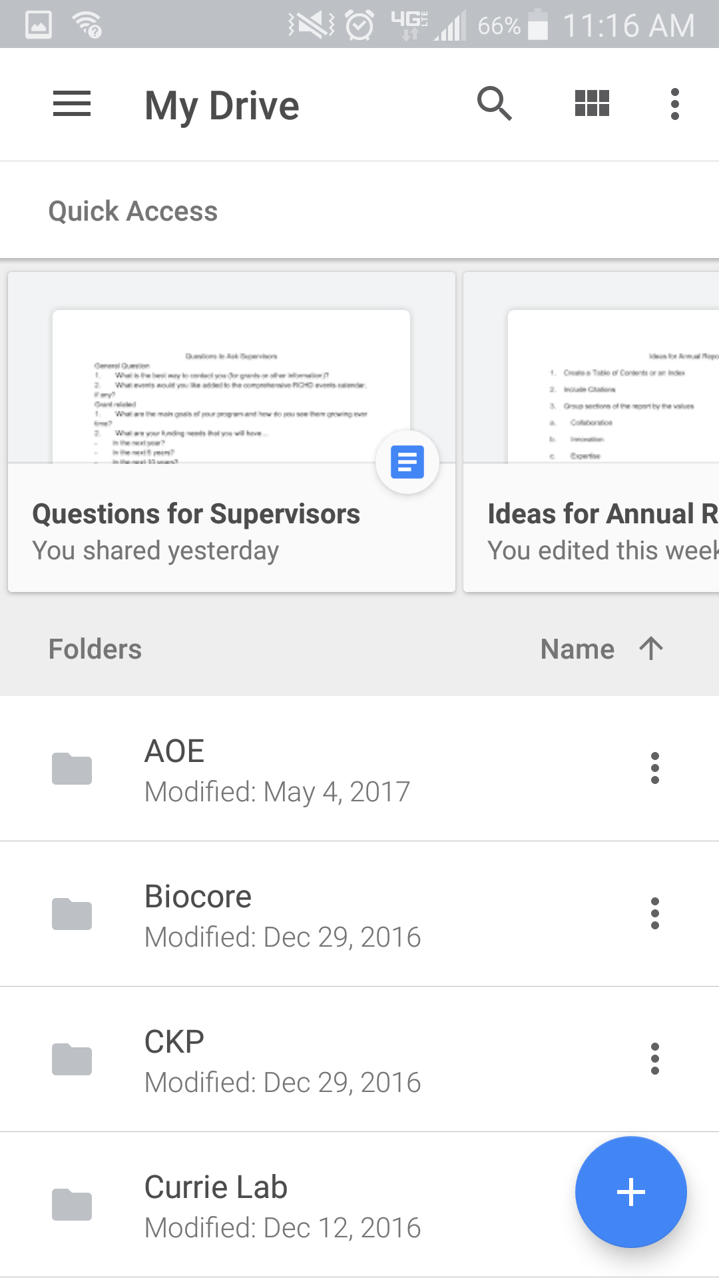
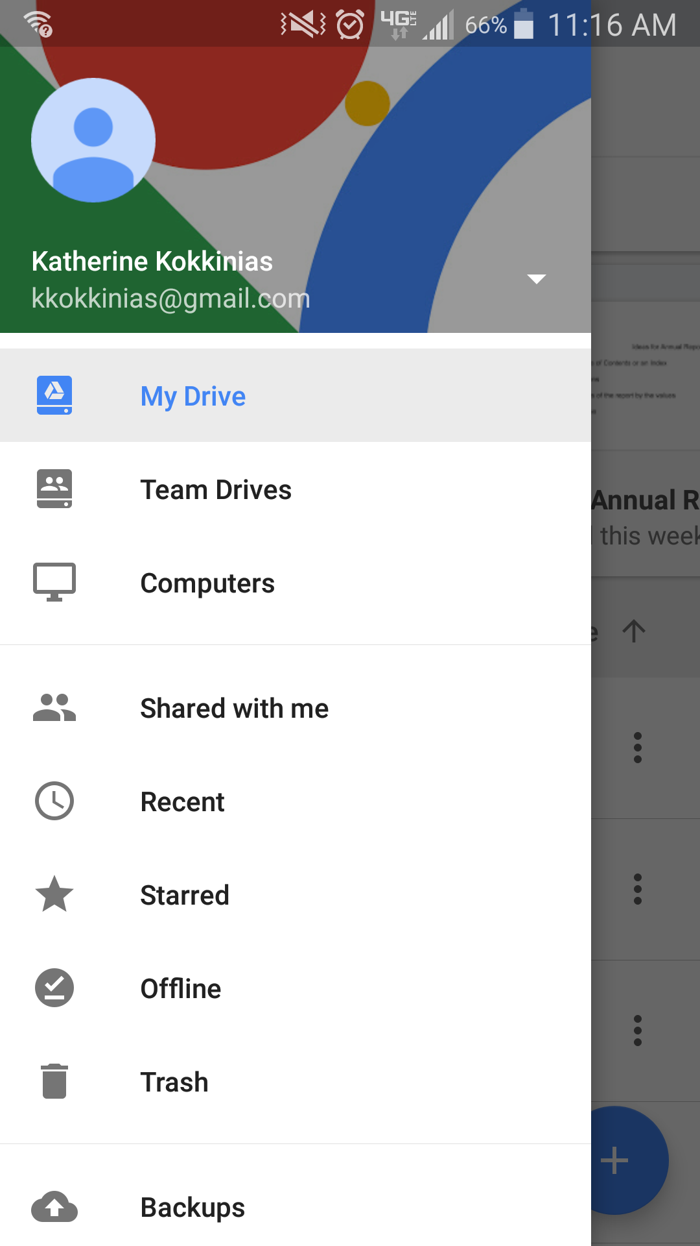
Phone view

Slide 17
Common Problems and Solutions
I just filled out my sheet and all my information is missing!
When filling out your sheet, make sure that you have access to a reliable Wi-Fi network. As you fill-out your sheet, the top right corner will indicate if you are online or not. If your Host Site doesn’t have Wi-Fi wait until you are in an area with reliable Wi-Fi network to fill-out the Digital Headcount Sheet.

Slide 18
What if I am still having problems?
Contact me (Katherine Kokkinias)
Katherine.kokkinias@vdh.virginia.gov
804-482-8018
rvafitnesswarriors@gmail.com

Slide 19
Questions?

